Slide 1
Dunbar ES GO Team Budget Allocation Meeting January 30,2025

Slide 2
Agenda
Action Items
Approval of Agenda
Approval of Previous Minutes
Strategic Plan Review and Update Previously discussed
Rank Strategic Priorities Previously discussed
Discussion Items
Review Budget Meeting Schedule- Review and update meeting calendar
Budget Allocation Presentation
Information Items
Principal’s Report
CCRPI (if not previously presented)
Additional items as needed
Committee Reports (if applicable)
Cluster Advisory Report (if applicable)
Announcements
Public Comment (if applicable)
Adjournment

Slide 3
Action Items: Preparing for Budget Development

Slide 4
Updates to the Strategic Plan
Enter all changes/updates to your plan – be sure to include accountability measures, as appropriate.
Before Presenting to
your GO Team:
Update or Remove If Your Team Completed this Step in the Fall

Slide 5
Action on the Updated Strategic Plan
The GO Team needs to TAKE ACTION (vote) on its updated Strategic Plan. After the motion and a second, the GO Team may have additional discussion. Once discussion is concluded, the GO Team will vote.
Before Presenting to
your GO Team:
Remove If Your Team Completed this Step in the Fall

Slide 6
DISCUSSION
Strategic Plan Priority Ranking
In preparation for the 2025-2026 Budget Development (January–March 2025), the GO Team needs to rank its Strategic Plan Priorities. Use the next slide to capture the priority ranking.
Before Presenting to
your GO Team:
Remove If Your Team Completed this Step in the Fall

Slide 7
Strategic Plan
Priority Ranking
Insert the school’s priorities from Higher to Lower
Higher
Before Presenting to
your GO Team:
Update or Remove If Your Team Completed this Step in the Fall
Lower

Slide 8
Action on the Strategic Plan Priorities
The GO Team needs to TAKE ACTION (vote) on its ranked Strategic Plan Priorities. After the motion and a second, the GO Team may have additional discussion. Once discussion is concluded, the GO Team will vote.
Before Presenting to
your GO Team:
Remove If Your Team Completed this Step in the Fall

Slide 9
Discussion Items

Slide 10
Update on Gifted Delivery Model
Gifted Model will be determined at a later date. We have 6 gifted students. 1 Gifted Teacher and 2 other staff members with Gifted Certification. We will continue with out Collab Model at this time.

Slide 11
Review & Discuss FY26 GO Team Budget Meeting Schedule
To ensure alignment with the district's budget timeline, we need to review and potentially adjust our current budget meeting schedule. This will ensure timely submission of all required materials.

Slide 12
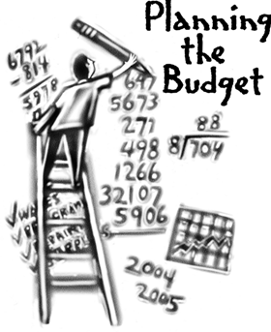
Overview of the FY26 GO Team Budget Process
Step 2 Principals Workshop FY 26 Budget
January 15th
Step 4 Principals Cluster Supt. Discussions
Step 1 Update Strategic Plan & Rank Priorities
Step 7 Principals HR Staffing Conferences Begin
Feb. 24th – Feb. 27th
Step 3 GO Team Budget Allocation Meeting
January 15th – January 31st
Step 8* GO Team Final Budget Approval Meeting
Budgets Approved by March 15th
Step 6 Cluster Supt. Review February 17th-21st
Step 5* GO Team Feedback Mtg. Early Feb. – Feb 14th
GO Teams are encouraged to have ongoing conversations
* GO Teams will need to take ACTION on the budget at these meetings.

Slide 13
Action on GO Team Budget Meeting Calendar
We will need to take ACTION (vote) to change our meeting calendar if we need to change our meetings to meet these deadlines:
Allocation Meeting: now-Jan 31
Feedback Meeting: February 6th February 13th
Approval Meeting: after staffing conference and before Friday, March 14: MARCH 6th

Slide 14
Budget Development

Slide 15
Norms
This is a meeting of the GO Team. Only members of the team may participate in the discussion. Any members of the public present are here to quietly observe.
We will follow the agenda as noticed to the public and stay on task.
We invite and welcome contributions of every member and listen to each other.
We will respect all ideas and assume good intentions.

Slide 16
GO Team Budget Development Process
Dunbar’s STRATEGIC PLAN…
is your roadmap and your role.
It is your direction, your priorities, your vision,
your present, your future.
Step 1: Data Review
Step 2: Strategic Plan Review
Step 3: Budget Parameters
(Strategic Priorities)
Step 4: Budget Development Process

Slide 17
Budget Allocation Meeting
What
During the first GO Team meeting the principal will provide an overview of the budget and position allocations, request(s) for turnaround and/or signature program funds and review changes to the Gifted Services delivery model (as needed)
Why
This meeting provides an opportunity for the principal and GO Team to ensure alignment on the school’s key strategic priorities, gain a deeper understanding of the budget and position allocations, discuss the proposed requests for signature program funds and provide input to drive the development of the draft budget.
When
January 16 – January 31

Slide 18
FY26 Budget Development Process
Principal’s Role
Design the budget and propose operational changes that can raise student achievement
Formulate strategies, implement and manage them at the school level
Focus on the day-to-day operations
Serve as the expert on the school
Hire quality instructional and support personnel
Collaborate with the GO Team on the use of school-level flexibility for position allocations, turnaround initiatives, and Signature Programs (NEW PROCESS FOR FY26)
The GO Team’s Role
Focus on the big picture (positions and resources, not people)
Ensure that the budget is aligned to the school’s mission and vision and that resources are allocated to support key strategic priorities
Collaborate with the Principal on the use of school-level flexibility for position allocations, turnaround initiatives, and Signature Programs (NEW PROCESS FOR FY26)

Slide 19
Mission Paul L. Dunbar is a school where excellence is expected, and all students are developed academically, socially, and emotionally in order to become globally competitive.
School Name: Dunbar Elementary School
Vision: Paul L. Dunbar Elementary is a school that nurtures and develops life-long learners who are problem solvers and internationally minded citizens.
SMART Goals
By May 2025, we will increase the % of students in grades 3-5 scoring proficient or above in reading by 5% from 22% to 27% and decrease students scoring beginning by 5% from 53% to 48% on MAP.
By May 2025, we will increase the % students in grades 3-5, scoring proficient or above in math by 5% from 10% to 15% and decrease students scoring beginning by 5% from 58% to 53%.
By May 2025, we will increase the % of CCRPI Attendance from 60% to 65%. (5% Growth)
APS Strategic Priorities & Initiatives
School Strategic Priorities
School Strategies
1.Offer an academically challenging curriculum that prepares students for college and career readiness
2. Effectively implement literacy curriculum to include explicit instruction
3. Effectively implement math curriculum
1A. Align the school schedule to create collaborative planning session for each teacher
1B. Aligned the instructional framework to maximize instructional time in the classroom.
1c.Integrate reading strategies and fluency facts into all exploratory courses
2a. Ensure all classroom are print –rich with Literacy Centers that focus on various reading skills
2b.. Ensure all classroom are using visual supports and engaging texts to increase literacy
3a 1Emphasize problem-solving strategies and encourage students to explain their reasoning
3b. Ensure Math Centers allows students to practice a variety of difference skills at their own pace
Fostering Academic Excellence for All Data
Curriculum & Instruction Signature Program
Building a Culture of Student Support
Whole Child & Intervention Personalized Learning
4. Effectively use existing and appropriate tools to measure, analyze, and communicate student progress
5. Effectively monitor attendance protocols and systems
6. Create a collaborative, inclusive, and responsive school culture
4a.. Complete ongoing data protocol with teachers during collaborative planning
4B. Use if frequent common assessments , analyze date, use to guide instruction
6a .Integrate SWD professional learning to structure special education instructional framework
4c/5b. Implement a school wide behavior plan (PBIS focused) / Implement attendance Incentives
Equipping & Empowering Leaders & Staff
Strategic Staff Support Equitable Resource Allocation
7. Build teacher capacity to meet the academic needs of the students
8. Create a Supportive Work Environment that motivates and retains staff.
6a.. Implement and Monitor professional learning collaborative planning to review instructional framework
6b. Continue to build instructional teams to support the teachers and students
7a .Integrate SEL Awareness and moment to build positive work environment
9. Provide necessary resources to enhance teaching and learning in all spaces
10. Attract and build capacity of talented and knowledgeable staff to meet school needs
11. Build and sustain parent engagement, community partnerships, and student voice
8a.. Implement Wellness Days and celebrate teachers and staff for attendance, data, personal accomplishments
9a. Increase math manipulatives, literacy manipulatives, and reading centers
10a Encourage Endorsements in Reading, math, technology to increase professional knowledge.
11a. Build and sustain parent engagement, community partnerships, and student voice
Creating a System of School Support
Strategic Staff Support
Equitable Resource Allocation
TBD: tbd
14

Slide 20
Strategic Plan
Example

Slide 21
Mission Paul L. Dunbar is a school where excellence is expected, and all students are developed academically, socially, and emotionally in order to become globally competitive.
School Name: Dunbar Elementary School
Vision: Paul L. Dunbar Elementary is a school that nurtures and develops life-long learners who are problem solvers and internationally minded citizens.
SMART Goals
By May 2025, we will increase the % of students in grades 3-5 scoring proficient or above in reading by 5% from 22% to 27% and decrease students scoring beginning by 5% from 53% to 48% on MAP.
By May 2025, we will increase the % students in grades 3-5, scoring proficient or above in math by 5% from 10% to 15% and decrease students scoring beginning by 5% from 58% to 53%.
By May 2025, we will increase the % of CCRPI Attendance from 60% to 65%. (5% Growth)
APS Strategic Priorities & Initiatives
School Strategic Priorities
School Strategies
1.Offer an academically challenging curriculum that prepares students for college and career readiness
2. Ensure a safe effective learning environment that encourages the use of an instructional framework to explicitly teach reading and math
3.Ensure that all students learn about multiple topics from a variety of different viewpoints.
1A. Align the school schedule to create collaborative planning session for each teacher
1B. Aligned the instructional framework to maximize instructional time in the classroom.
1c.Integrate reading strategies and fluency facts into all exploratory courses
2a. Ensure all classroom are print –rich with Literacy Centers that focus on various reading skills
2b.. Ensure all classroom are using visual supports and engaging texts to increase literacy
3a 1Emphasize problem-solving strategies and encourage students to explain their reasoning
3b. Ensure Math Centers allows students to practice a variety of difference skills at their own pace
Fostering Academic Excellence for All Data
Curriculum & Instruction Signature Program
Building a Culture of Student Support
Whole Child & Intervention Personalized Learning
4a.. Complete ongoing data protocol with teachers during collaborative planning
4B. Use if frequent common assessments , analyze date, use to guide instruction
6a .Integrate SWD professional learning to structure special education instructional framework
4c/5b. Implement a school wide behavior plan (PBIS focused) / Implement attendance Incentives
4. Effectively use existing and appropriate tools to measure, analyze, and communicate student progress
5. Effectively monitor attendance protocols and systems
6. Create a collaborative, inclusive, and responsive school culture
Equipping & Empowering Leaders & Staff
Strategic Staff Support Equitable Resource Allocation
6a.. Implement and Monitor professional learning collaborative planning to review instructional framework
6b. Continue to build instructional teams to support the teachers and students
7a .Integrate SEL Awareness and moment to build positive work environment
7. Build teacher capacity to meet the academic needs of the students
8. Create a Supportive Work Environment that motivates and retains staff.
8a.. Implement Wellness Days and celebrate teachers and staff for attendance, data, personal accomplishments
9a. Increase math manipulatives, literacy manipulatives, and reading centers
10a Encourage Endorsements in Reading, math, technology to increase professional knowledge.
11a. Build and sustain parent engagement, community partnerships, and student voice
Creating a System of School Support
Strategic Staff Support
Equitable Resource Allocation
9. Provide necessary resources to enhance teaching and learning in all spaces
10. Attract and build capacity of talented and knowledgeable staff to meet school needs
11. Build and sustain parent engagement, community partnerships, and student voice
TBD: tbd
14

Slide 22
Dunbar ES Strategic Plan
Priority Ranking
Higher
Attract and build capacity of talented and knowledgeable staff to meet school needs.
Ensure a safe and effective learning environment that encourages the use of an instructional framework utilized across all content areas for more personalized learning.
Offer an academically challenging curriculum that prepares students for college, career, and citizenship.
Ensure that all students learn about multiple topics from a variety of different viewpoints.
Build teacher capacity with the ability to meet the diverse social and academic needs of students.
Effectively monitor attendance protocols and systems.
Create a collaborative, inclusive, and responsive school culture embracing the diverse communities that comprise the Dunbar ES family.
Create an environment that motivates and retains staff members.
Effectively use existing and appropriate tools to measure, analyze, and communicate student progress.
Provide necessary and salient resources to enhance teaching and learning in all spaces.
Build and sustain parent engagement, community partnerships, and student voice.
Lower

Slide 23
FY 26 Budget Parameters
FY26 Ranked School Priorities | Rationale
1) Attract and build capacity of talented and knowledgeable staff to meet school needs. | Recruiting and retaining highly skilled educators is key to a school’s success. Building staff capacity through ongoing professional development ensures that the school can adapt to evolving educational challenges and provide students with a top-notch learning experience.
Ensure a safe and effective learning environment that encourages the use of an instructional framework to explicitly teach reading and math. | A safe and structured environment fosters student engagement and academic success. An instructional framework ensures consistency and effectiveness in teaching core subjects like reading and math, which are foundational to all areas of learning.
Offer an academically challenging curriculum that prepares students for college and career readiness. | A challenging curriculum equips students with the skills and knowledge they need to succeed in higher education and future careers.

Slide 24
FY 26 Budget Parameters
FY26 School Priorities | Rationale
Ensure that all students learn about multiple topics from a variety of different viewpoints | An instructional framework ensures consistency and effectiveness in teaching core subjects like reading and math, which are foundational to all areas of learning
Build teacher capacity with the ability to meet the diverse social and academic needs of students | Investing in teacher development ensures that educators are equipped with the skills and knowledge to meet diverse student needs.
Effectively monitor attendance protocols and systems | Regular attendance is critical to academic achievement.
Create a collaborative, inclusive, and responsive school culture embracing the diverse communities… | A positive school culture supports both academic and social-emotional development.

Slide 25
FY 26 Budget Parameters
FY26 School Priorities | Rationale
8. Create an environment that motivates and retains staff members | Dedicated time for students to receive specific interventions and/or enrichment.
9. Effectively use existing and appropriate tools measure, analyze, and communicate student progress | Using data-driven approaches allows educators to monitor and address student needs in real-time.
10. Provide necessary and salient resources to enhance teaching and learning in all spaces | Adequate resources enable effective teaching and learning by supporting diverse instructional strategies and student needs.
11. Build and sustain parent engagement, community partnerships, and student voice. | Engaging parents and the community creates a support network that enhances student success. Encouraging student voice promotes agency, motivation, and leadership.

Slide 26
Discussion of Budget Allocation

Slide 27
Executive Summary
This budget represents an investment plan for our school’s students, employees and the community as a whole.
The budget recommendations are tied directly to the school’s strategic vision and direction.
The proposed budget for the general operations of the school are reflected at $ 5,732,995
This investment plan for FY26 accommodates a student population that is projected to be _269____ students, which is a increase/decrease of ___207___ students from FY25.

Slide 28
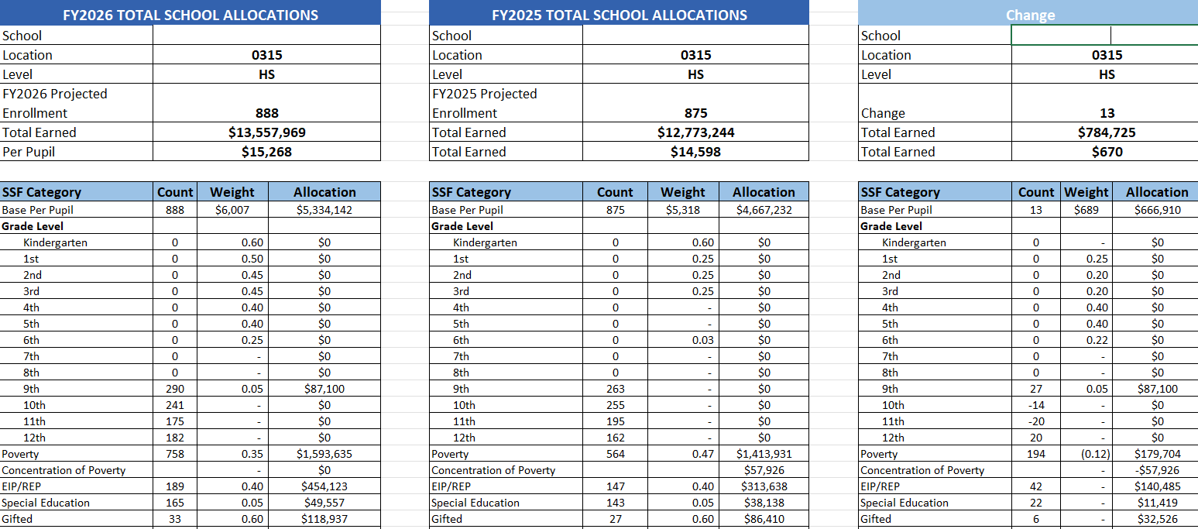
School Allocation Tab Overview
The Allocation Tab has 3 tables that show the allocations for FY26, FY25, and the Change in each area. This helps you understand how our school earned funds and positions for FY26 in comparison to FY25, and how changes in each line impact our overall school budget.

Slide 29
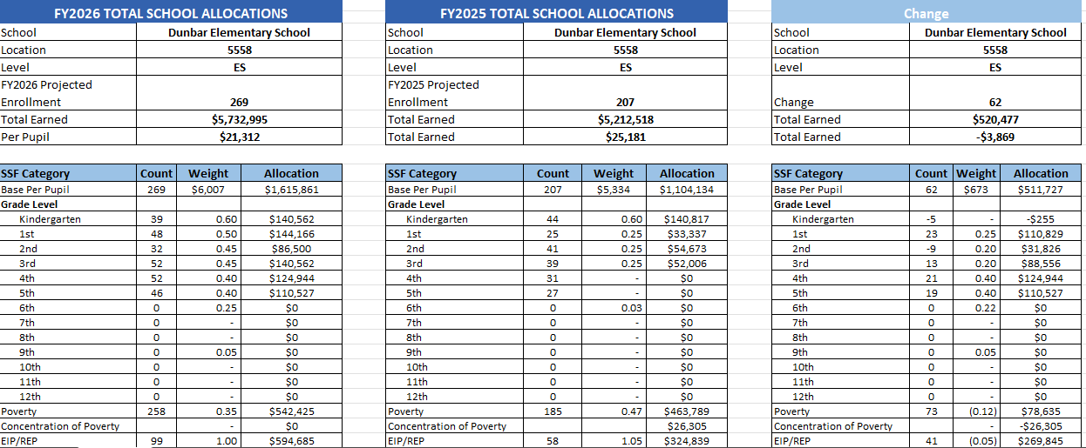
Dunbar ES SSF Allocations

Slide 30
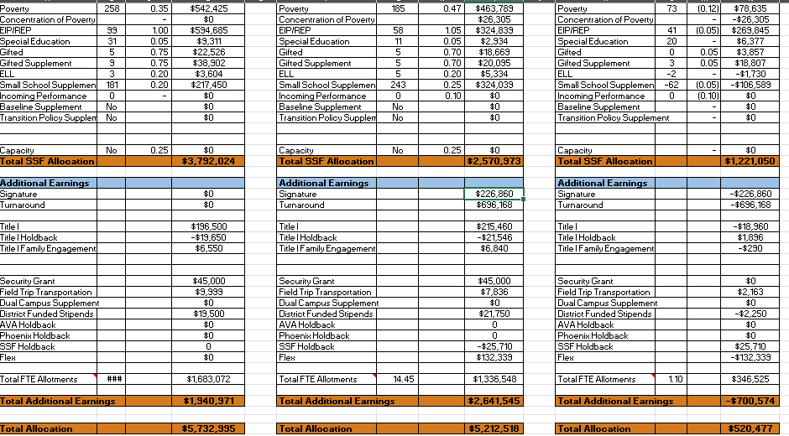
Dunbar ES Additional Earnings

Slide 31
Summary Tab Overview
Position Title | Earned | Funded | Staffed | Dif | Comments
Teachers
Middle School Core |  | 49.50 | - | (49.50)
Middle Electives |  | 19.00 | - | (19.00)
Teacher Math 6-8 |  |  | 11.00 | 11.00
Teacher Science 6-8 |  |  | 10.00 | 10.00
Teacher Social Studies 6-8 |  |  | 10.00 | 10.00
Teacher ELA 6-8 |  |  | 9.00 | 9.00
Teacher Art 6-8 |  |  | 2.00 | 2.00
Teacher Band 6-8 |  |  | 1.00 | 1.00
Teacher Music 6-8 |  |  | 2.00 | 2.00
Teacher Orchestra 6-8 |  |  | 1.00 | 1.00
Teacher Physical Ed 6-8 |  |  | 7.00 | 7.00
Teacher Performing Arts 6-8 |  |  | 2.00 | 2.00
Teacher World Language 6-8 |  |  | 12.00 | 12.00
Teacher Gifted |  | 13.00 | 11.00 | (2.00)
Teacher Social Emotional Learning |  |  | - | -
EIP TEACHERS |  | 3.50 | 5.00 | 1.50
Teacher REP 6-12 |  |  | 5.00 | 5.00
The Summary Tab provides a summary of the staff in our school. The columns show how many positions are:
Earned – positions allocated by district departments. There is no school-level flexibility with these positions.
Funded – District’s recommended staffing for positions where there is school-level flexibility with staffing the position.
Staffed – This shows how the position is currently staffed at the school.
Difference—This shows the difference between the recommendation in the Funded column and the Staffed Column.
Comments: The principal must provide comments if there is a difference in what is Funded and Staffed. Principals and GO Teams will discuss the rationale provided for the Comments section.
Example

Slide 32
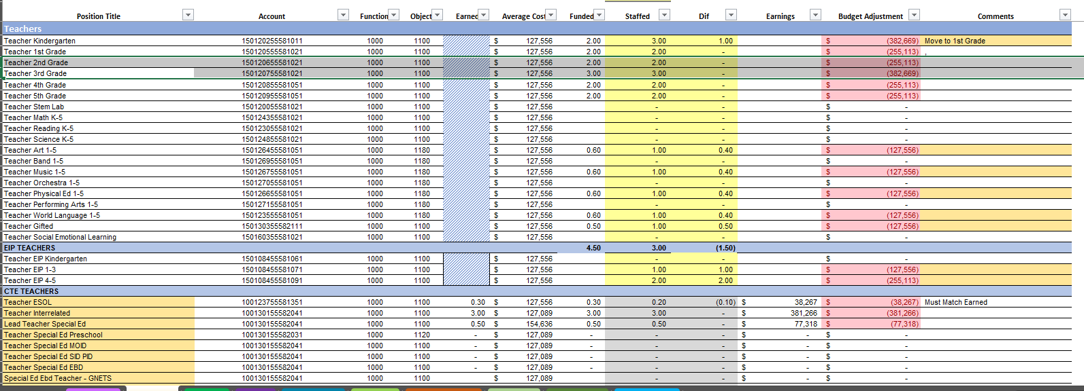

Slide 33
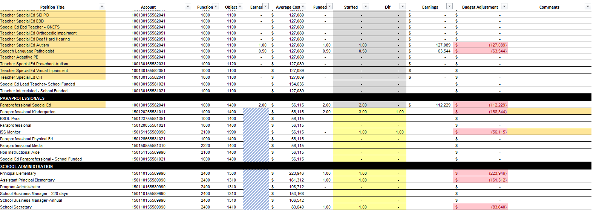

Slide 35
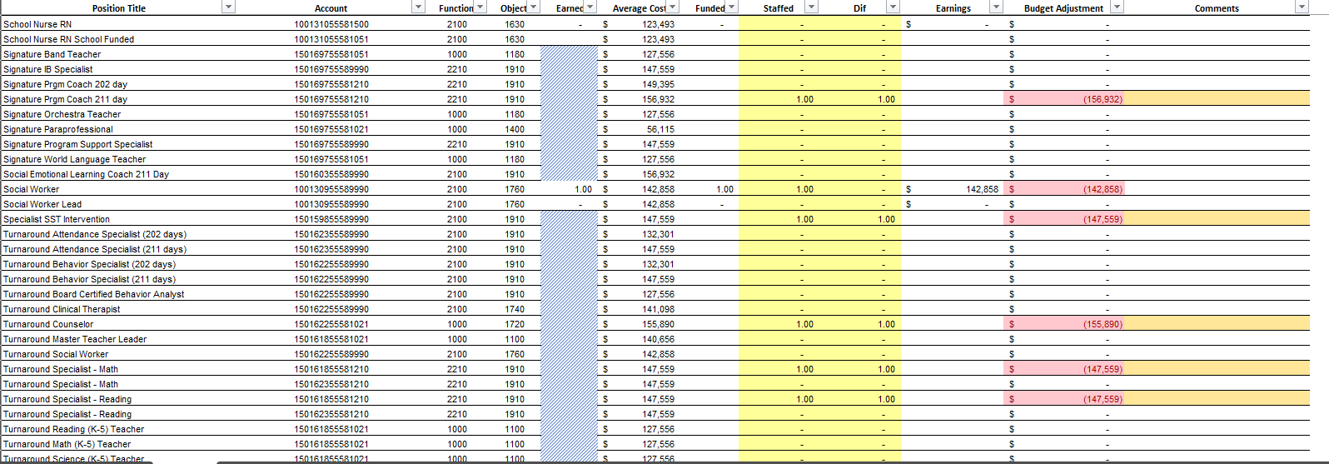

Slide 36
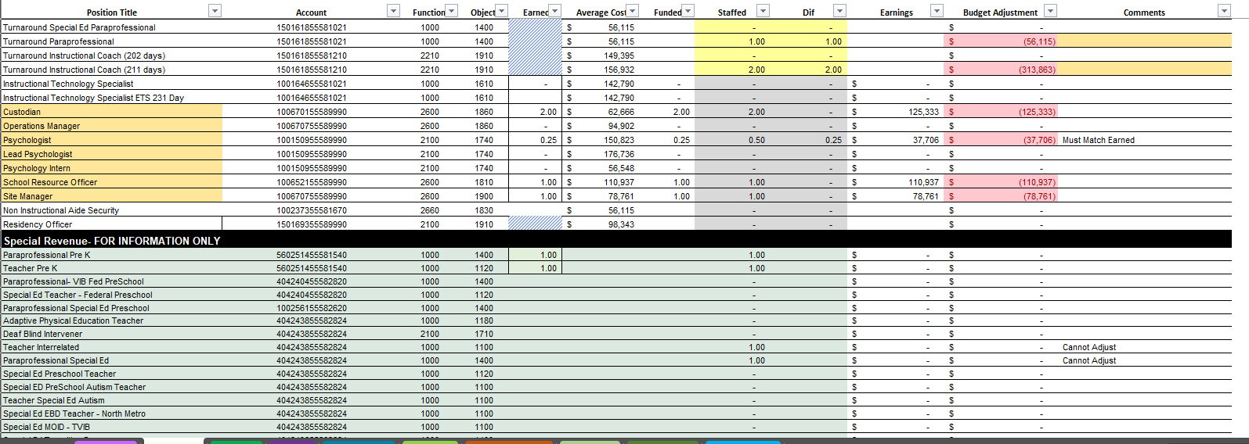

Slide 38
(slide 32) Non-Staffing Tab Overview
Description | Rec. | Allocation | Diff | Notes
Reserve | $ 291,149 | $ 291,149 | $ -
Teacher Stipends |  |  | $ -
Secretary Overtime |  |  | $ -
Contracted Services for Instruction |  |  | $ -
Contracted Services for Professional Development |  |  | $ -
Web-based Subscriptions and Licenses |  |  | $ -
Signature Program Communication/Shipping Fee |  |  | $ -
Computer Software |  | $ - | $ -
Mileage |  |  | $ -
Student Transportation-APS Buses |  |  | $ -
District Funded Field Trips | $ 60,886 | $ 60,886 | $ -
Teaching/Other Supplies | $ 81,900 |  | $ (81,900)
Signature Program Supplies |  |  | $ -
Computer Equipment |  |  | $ -
Media Supplies | $ 13,104 |  | $ (13,104)
The Non-Staffing Tab shows how funds are allocated for non-staff items in the school. There is school-level flexibility for most of these items. The tab has columns for:
Recommended—District’s recommended amount to spend on the line item.
Allocation – This shows how much money has been allocated towards the line item.
Difference—This shows the difference between the recommended amount and the allocation.
Notes: The principal must provide comments if there is a difference in what is Recommended and what is Allocated. Principals and GO Teams will discuss the rationale for the notes section.
Example

Slide 39
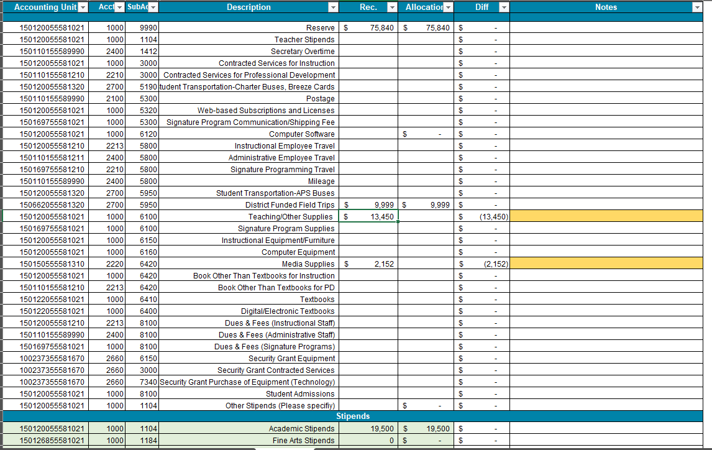

Slide 40
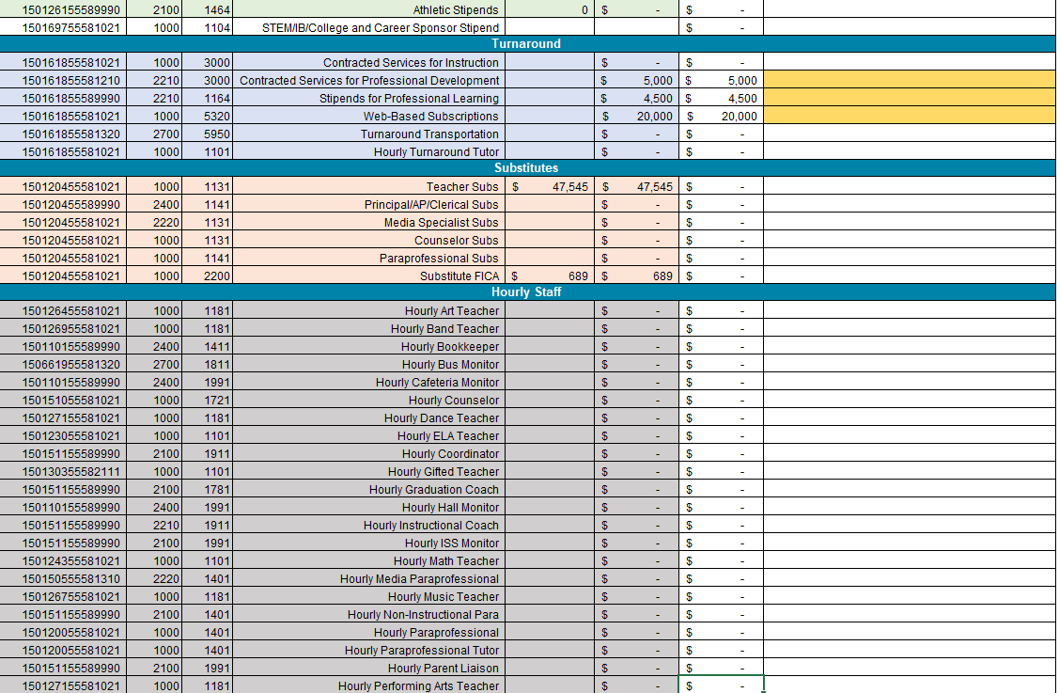
Non-Staffing Tab Continued

Slide 42
Signature and Turnaround Fund Process Overview
Overview
* The district is piloting a zero-based budgeting (ZBB) process for Signature and Turnaround Program Funds this year.
* Zero-based budgeting (ZBB) is a budgeting process that allocates funding based on program efficiency and necessity rather than budget history. As opposed to traditional budgeting, no item is automatically included in the next budget.
* As such the initial allocation for these programs at all schools will be $0.
Process
* Principals will develop proposed requests for the personnel and non-personnel they need to support the Signature and/or Turnaround Programs at their schools.
* Principals will share and discuss their proposals and rationale for the proposals with their school GO Team for feedback.
* After discussing with their GO Team, principals will submit their request for review by January 31st. Funding for these programs will be provided the week of February 3rd.

Slide 43
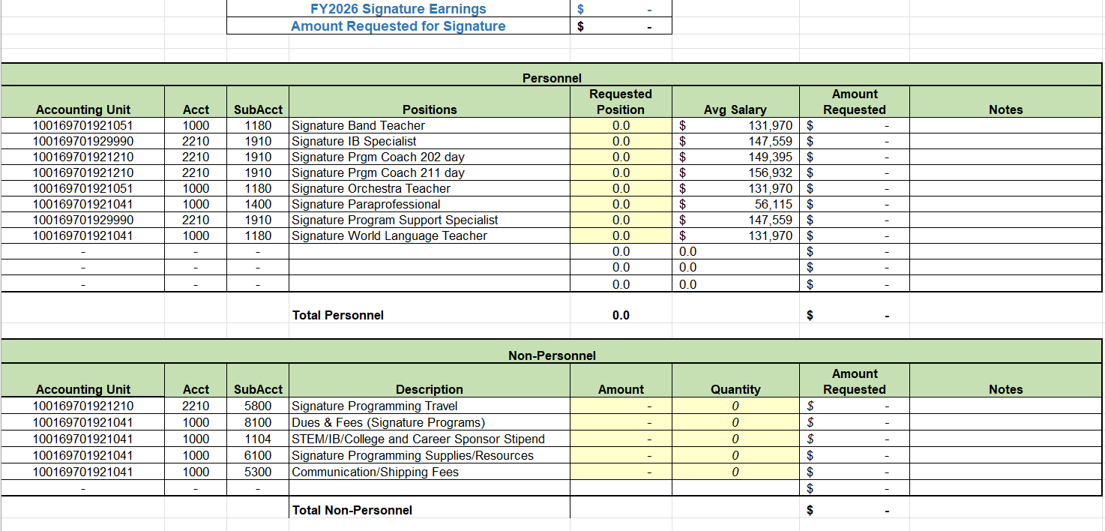
Proposed FY26 Signature Program Fund Request

Slide 44
Dunbar’s Signature Request

Slide 45
Proposed Rationale for FY26 Signature Program Fund Requests
FY26 Signature Program Fund Request | Rationale
Utilize IB Signature Coach to implement the signature program | IB has specific requirements to remain authorized. An IB Coach will ensure the school is meeting the requirements.
Resources and Supplies | IB Fees and Supplies for program implementation over the course of the school year.

Slide 46
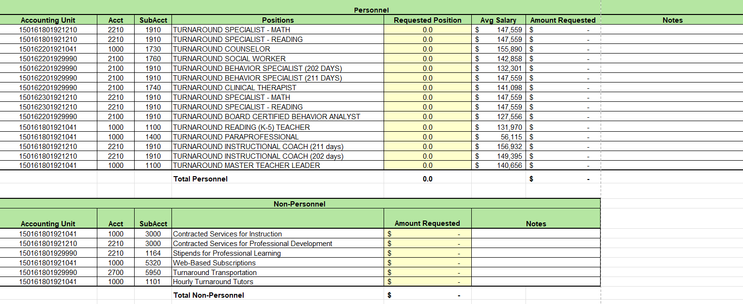
Proposed FY26 turnaround Program
Fund Request

Slide 48
Proposed Rationale for FY26 Signature Program Fund Requests
FY26 Turnaround Fund Request | Rationale
Reading Specialist Math Specialist | Provides Interventions in small groups to build foundational skills
Turnaround Counselor | Provides small group sessions for all students; implements SEL program, operates several mentorship programs
ELA Turnaround Coach Math Turnaround Coach | Provide reading and math support to teachers during PLC. Building content capacity and pedagogy.

Slide 49
What’s Next?
February
GO Team Feedback Meeting(s) before February 14th
ACTION (i.e.- GO Team votes) on draft budget before February 14th
Cluster Superintendent Review (February 17-21)
HR Staffing Conferences (February 24– February 27)
March
Final GO Team Approval Meeting (AFTER your school’s Staffing Conference and BEFORE Friday, March 14th)
ACTION (i.e.- GO Team votes) on final budget recommendation before March 14

Slide 50
Questions?
Thank you for your time and attention.

Slide 51
Thank you

